Slide 1
Indicators and buffers

Slide 2
Indicators
An acid-base indicator is either a weak acid and its conjugate base that exhibits a color change as the concentration of hydrogen (H⁺) or hydroxide (OH⁻) ions changes in an aqueous solution.

Slide 3
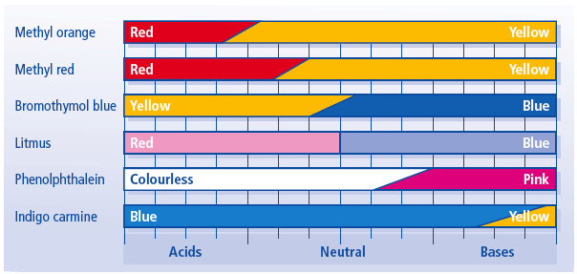
Examples

Slide 4

Acid - Base indicators (also known as pH indicators) are substances which change colour with pH. They are usually weak acids or bases, which when dissolved in water dissociate slightly and form ions. Consider an indicator which is a weak acid, with the formula HIn. At equilibrium, the following equilibrium equation is established with its conjugate base:

Slide 5
The acid and its conjugate base have different colours. At low pH values the concentration of H₃O⁺ is high and so the equilibrium position lies to the left. The equilibrium solution has the colour A. At high pH values, the concentration of H₃O⁺ is low - the equilibrium position thus lies to the right and the equilibrium solution has colour B.

Slide 6
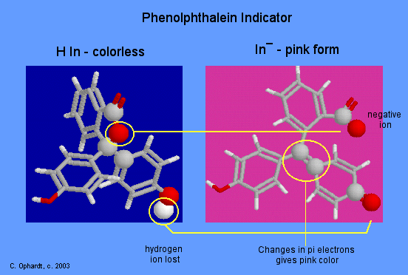
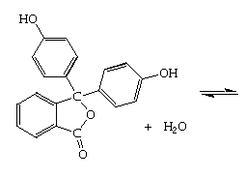
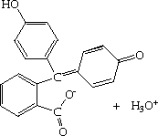
Phenolphthalein is an example of an indicator which establishes this type of equilibrium in aqueous solution:
Phenolphthalein is a colourless, weak acid which dissociates in water forming pink anions. Under acidic conditions, the equilibrium is to the left, and the concentration of the anions is too low for the pink colour to be observed.
However, under alkaline conditions, the equilibrium is to the right, and the concentration of the anion becomes sufficient for the pink colour to be observed.

Slide 7
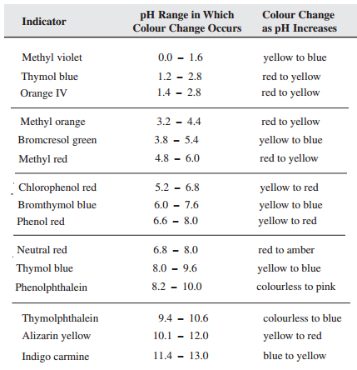
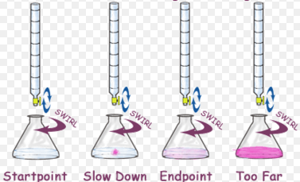
Indicators don't change colour sharply at one particular pH. Instead, they change over a narrow range of pH.

Slide 8






Indicators are complicated organic weak acids or bases with complicated structures.
For simplicity, lets represent a general indicator by the formula HIn, and its ionization in a solution by the equilibrium, HIn = H⁺ + In⁻,
and define the equilibrium constant as K_{ai},
K_{ai} = ----------.
Which can be rearranged to give
Therefore, the ratio [In⁻]/ [HIn] depends on the pH, and determines the colour of the solution

Slide 9
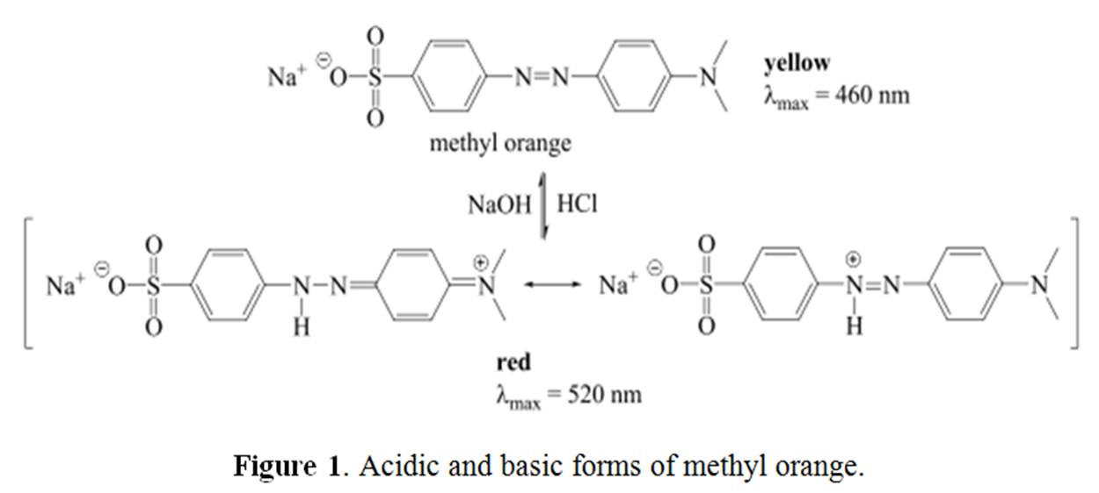
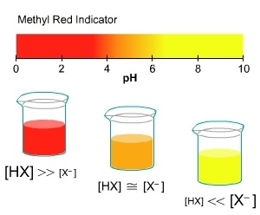
With methyl orange, the solution is red if [HIn]>> [In⁻], yellow if [In⁻]>>[HIn], and varying shades of orange when [HIn] and [In⁻] are about the same.
Therefore, at the end-point of the titration,
When [HIn(aq)] = [In⁻(aq)]
[In⁻(aq)]/ [HIn(aq)] = 1, and
K_{a} = [H₃O⁺]_{eqm} or pK_{a} = pH

Slide 10
Buffers
A buffer is a solution that can resist pH change upon the addition of an acidic or basic substances. It is able to neutralize small amounts of added acid or base, thus maintaining the pH of the solution relatively stable.

Slide 11
What is a buffer composed of?
A buffer is simply a mixture of a weak acid and its conjugate base or a weak base and its conjugate acid.
Buffers work by reacting with any added acid or base to control the pH.

Slide 12
Examples
the following could function as buffers when together in solution:
Acetic acid CH₃COOH and a salt containing its conjugate base, the acetate anion (CH₃COO⁻), such as sodium acetate (CH₃COONa)
Pyridine weak base C₅H₅N and a salt containing its conjugate acid, the pyridinium cation (C₅H₅NH⁺), such as Pyridinium Chloride.
Ammonia NH₃ and a salt containing its conjugate acid, the ammonium cation, such as Ammonium Hydroxide (NH₄OH)
H₂CO₃/HCO₃⁻

Slide 13
How does a buffer works
let's consider the action of a buffer composed of the weak base ammonia, NH₃, and its conjugate acid, NH₄ ⁺. When HCl is added to that buffer, the NH₃ consumes the acid's proton to become NH₄ ⁺.
Because that proton is locked up in the ammonium ion, this proton does not significantly increase the pH of the solution.
When NaOH is added to the same buffer, the ammonium ion donates a proton to the base to become ammonia and water. Here the buffer also serves to neutralize the base.

Slide 14
a buffer works by replacing a strong acid or base with a weak one. The strong acid's proton is replaced by ammonium ion, a weak acid. The strong base OH⁻ was replaced by the weak base ammonia.
These replacements of strong acids and bases for weaker ones give buffers their extraordinary ability to moderate pH.

Slide 15
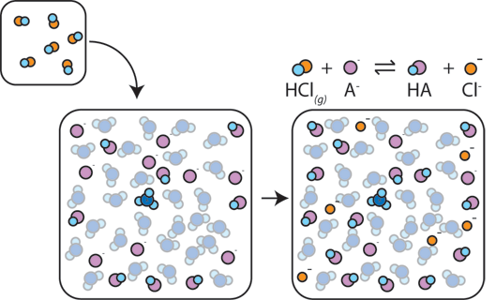
If a strong acid is added to a buffer, the weak base will react with the H⁺ from the strong acid to form the weak acid HA: H⁺ + A⁻ → HA. The H⁺ gets absorbed by the A⁻ instead of reacting with water to form H₃O⁺ (H⁺), so the pH changes only slightly.

Slide 16
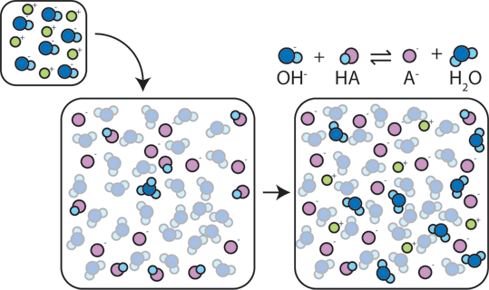
If a strong base is added to a buffer, the weak acid will give up its H⁺ in order to transform the base (OH⁻) into water (H₂O) and the conjugate base: HA + OH⁻ → A⁻ + H₂O. Since the added OH⁻ is consumed by this reaction, the pH will change only slightly.

Slide 17
The pH of a buffer
Is determined by –
K_{a} of the weak acid
Ratio of weak base A- to weak acid HA in solution.
If buffer has more acid than base then [H⁺] is more, hence low pH.
When [A⁻]=[HA] then [H⁺] = K_{a}
As long as [A⁻]/[HA] is between 1/10 and 10. the pH is within 1 unit and the solution is buffered.

Slide 18
Buffer capacity
Buffer capacity is a measure of the efficiency of a buffer in resisting changes in pH.
Ability of a solution to neutralize excess acid or base with out a remarkable change to its pH.
It’s the measure of the amount of acid or base the buffer can neutralize.
Buffers are most effectives when they have high and similar conc of acid and bases.

Slide 19
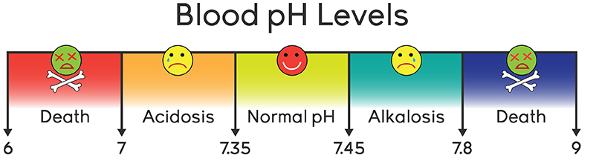
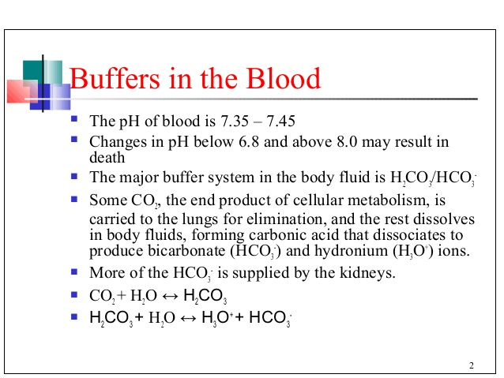

Slide 20
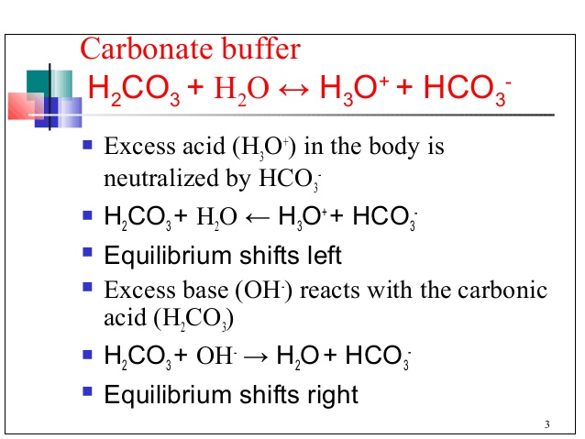

Slide 21
